Slide 1
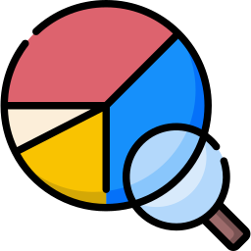



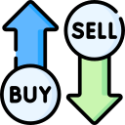


Software Market Research Presentation

Slide 2
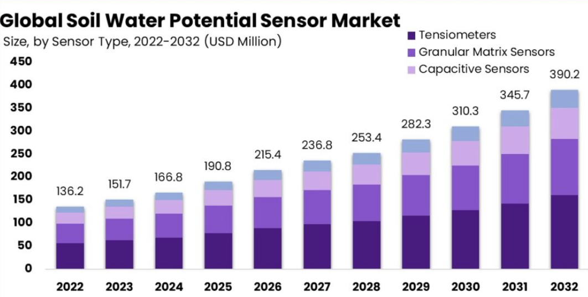

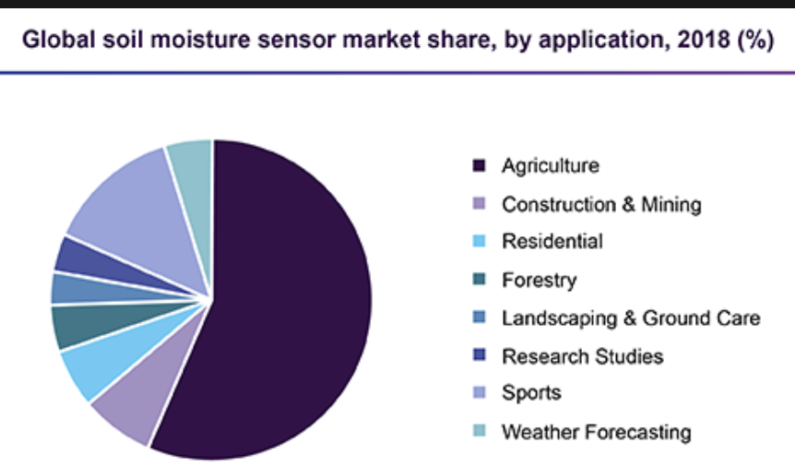
Market Overview
Projected to increase year over year
23% increase in 11 years
Majority of the sensor will be used in:
Agriculture
Construction and Mining
Key Points:
Rising Interest in Plant Care
Integration of Technology
Promotion of Sustainability
Market Growth

Slide 3
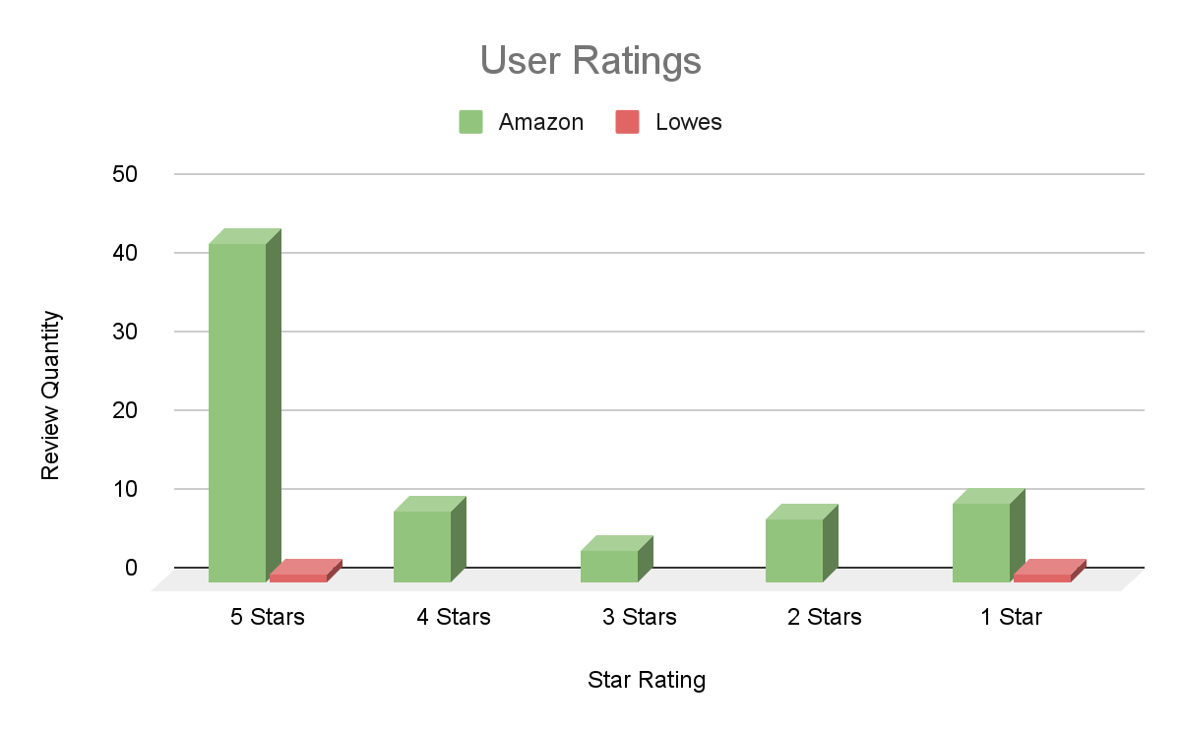
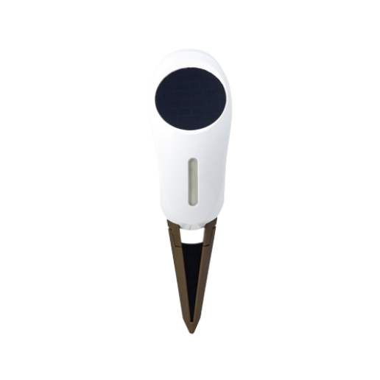

Netro Analysis
Overview: ~$80
Periodically collects the soil moisture, ambient temperature, sunlight condition
Features & Offerings:
Wifi connected
Solar powered
Runs on Android and IOS devices
Sunlight, temperature, and moisture sensor
Hands-on Evaluation:
Reviewers emphasize the “modern” aspect of the device such as weather integration and prediction.
The whisperer mobile application, lets you set up “zones” for multiple sensors
Device only uses 2.4GHz and may not work with 5Ghz networks
Critical Review:
Can be inaccurate and unreliable
Only for outdoor plants, doesn't work in low light conditions
Low durability

Slide 4
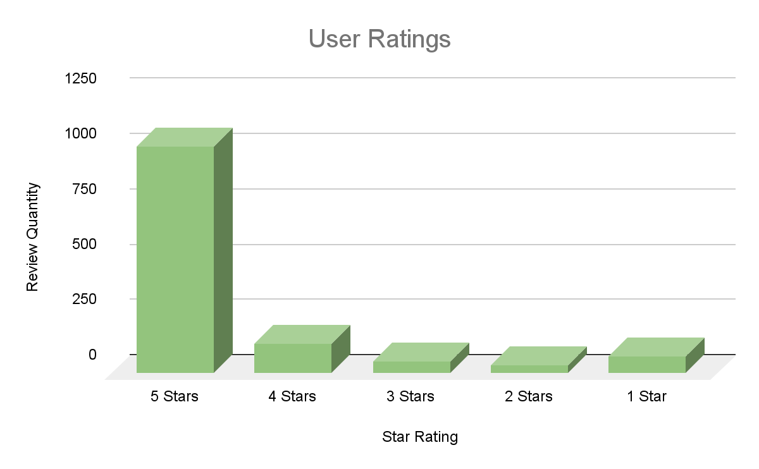
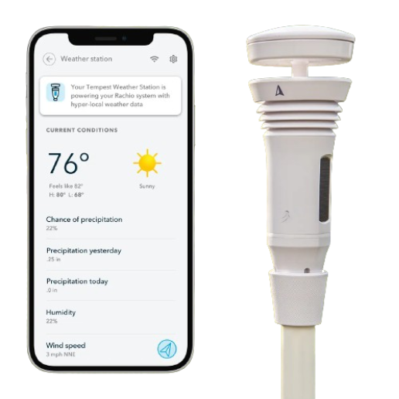
Rachio Analysis
Overview: ~$400
A device that measures and reports the weather, aiding in watering scheduling. View real time data in the Rachio app such as wind speeds, ambient light, temperature and humidity sensing information.
Features & Offerings:
Wireless
Solar Powered
Low maintenance
Alexa-Enabled
Easy Installation
Hands-on Evaluation:
Intuitive app
Convenient wireless connection
Complex setup for non tech-savvy
In-app customization is complex
Comprehensive range of sensors
Minimal maintenance
Critical Reviews:
Rain and wind readings are not accurate or reliable many times
Relatively short lifespan
Some communication issues
Notes:
Overview:

Slide 5
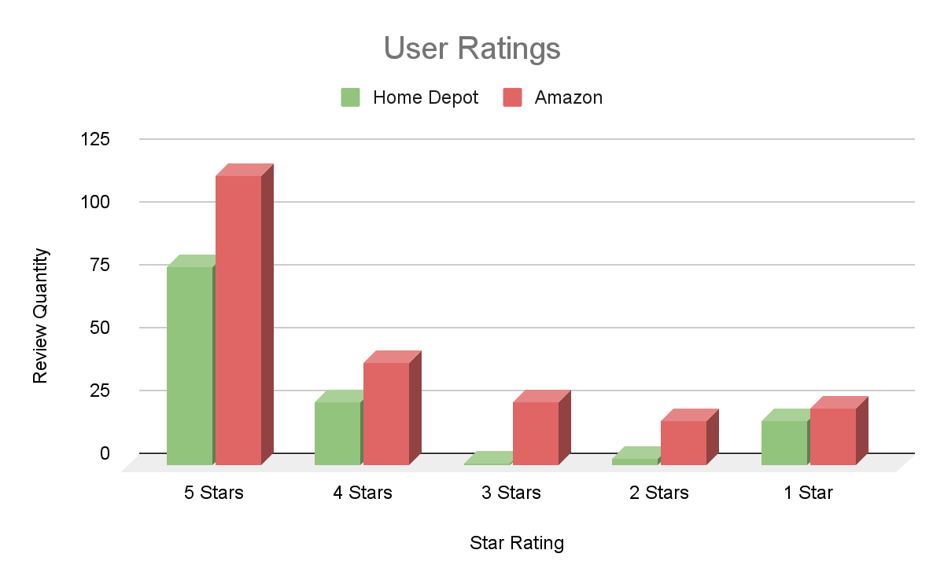
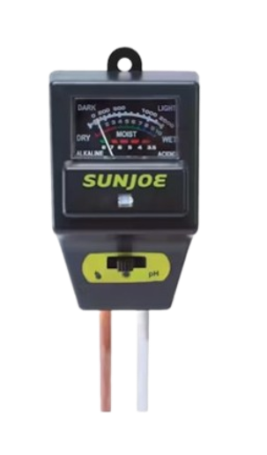

Sun Joe Analysis
Overview: ~$12
3-in-1 soil meter that tests for proper moisture, pH and sunlight for healthier soil and happier plants. It is designed for indoor and outdoor use for testing soil condition and plant care
Features & Offerings:
Sunlight intensity sensor
Moisture sensor
pH sensor
No batteries required
Gauge for easy monitoring
Critical Reviews:
A lot of users tend to use the device for a specific functionality, not all of them
Inaccurate reading when switching between different plants
Hands-on Evaluation:
Relatively low quality material
Ready for use right out the box
Need to select desired test mode
Accuracy is iffy or may not work entirely
Notes:
Overview:

Slide 6
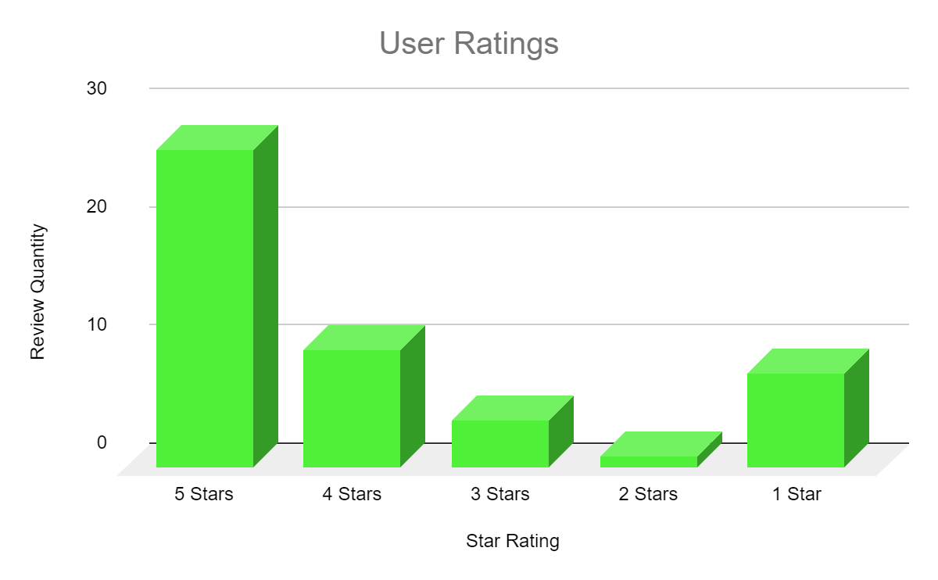


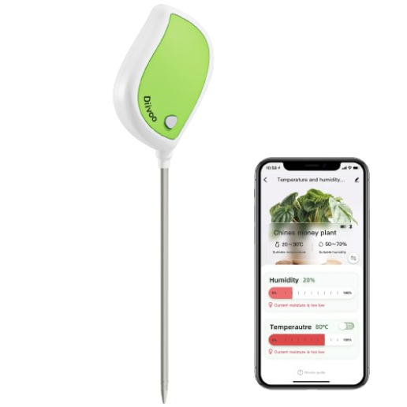
Diivoo Analysis
Overview: ~$25
A soil moisture meter that connects to your phone via Bluetooth, displaying real-time temperature, humidity, and soil data.
Lists preset data on the watering frequency, attributes and standard temperature and humidity ranges for 32 most common plants.
Features & Offerings:
Bluetooth connectivity
32 predefined plants data
Custom list for 30 additional plants
Custom plant recommendations
Critical Reviews:
Repetitive annoyance having to press a button on the device to get readings
Has Limited memory for user defined plants.
Hands-on Evaluation:
High quality build
Easy setup
Intuitive app
Valuable plant database
Restricted to 30 plant types
Accuracy sometimes iffy
Notes:
Overview: A soil moisture meter that connects to your phone via Bluetooth, displaying real-time temperature and humidity data. It provides information on your plants' properties and watering frequency, as well as soil temperature and humidity-zoe reference table. Lists preset data on the watering frequency, attributes and standard temperature and humidity ranges for 32 most common plants.

Slide 7


Opportunity Assessment
01
Strengths
Comprehensive Data Analysis
Reusability
02
Weaknesses
Bluetooth Limitation
Dependence on Technology
03
Opportunities
Educational Content
Solar Powered Battery
04
Threats
Competition
Market Saturation

Slide 8
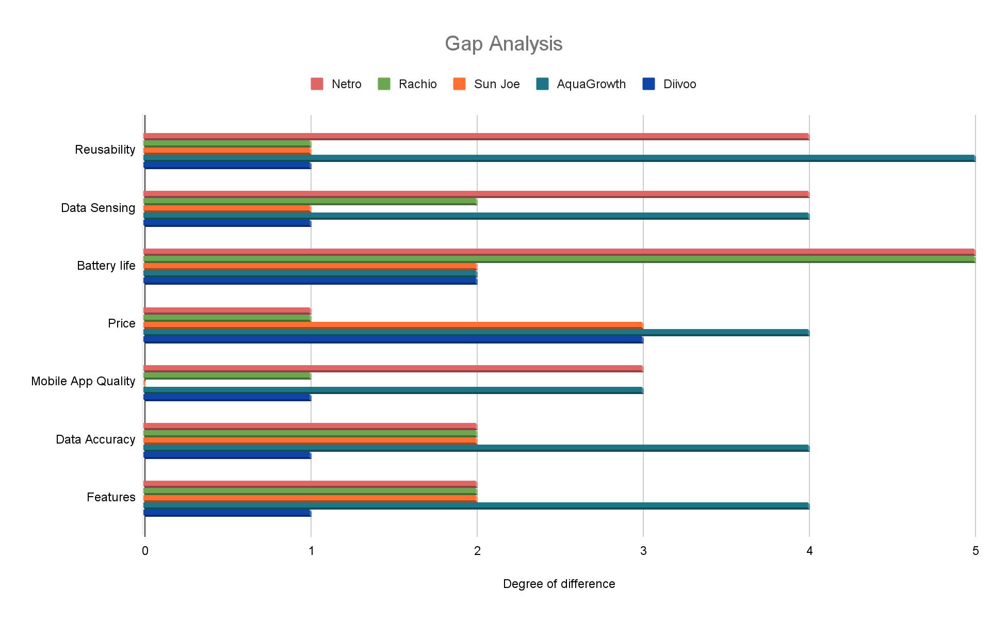
Opportunity Assessment

Slide 9




Strategic Positioning
Competitors: Aqua Growth competes with notable competitors such as Netro, Rachio, Sun Joe, and Diivoo in the plant sensor device market.
What separates us from our competitors…
Complete set of sensors (Temperature, Humidity, Moisture, and Sunlight Sensors)
Focus on reusability
Extended battery life
Potential Challenges
Bluetooth support
Data accuracy
Unlimited plant profiles
Notes:
Providing bluetooth connectivity between the device and mobile application is challenging. Therefore we plan to use a Generic Attribute Profile approach that assigns a mobile application as a client and device as a peripheral to facilitate the data transfer between the devices.
For unlimited plant profiles it can lead to scalability and configuration issues inside of our mobile application. Therefore we plan to figure out a generic design pattern to provide unlimited plant profiles and a way to store and manage in a database.

Slide 10


 |  |  |  | Aqua Growth
Reusability | Unlimited | Limited | Limited | Unlimited | Limited
Data Sensing | Automatic | Automatic | Manual | Automatic | Manual
Battery life | Solar | Solar | Battery | Battery | Battery
Price | Expensive | Expensive | Competitive | Competitive | Competitive
Mobile App Quality | Good | Basic | None | Good | Basic
Data Accuracy | Moderate | High | Moderate | High | Moderate
Sensors features | Rich | Moderate | Few | Rich | Moderate
The main categories we’re prioritizing are Reusability, Extended Battery Life, Features, and Data Accuracy.
Notes:
Compared to other competitors,

Slide 11
 |  |  |  | Aqua Growth
Humidity Sensor | X | ✔ | X | ✔ | ✔
Temperature Sensor | ✔ | ✔ | X | ✔ | ✔
Moisture Sensor | ✔ | X | ✔ | ✔ | ✔
Sunlight Sensor | ✔ | X | ✔ | ✔ | X
Mobile Application | ✔ | ✔ | X | ✔ | ✔
Dashboard | ✔ | ✔ | X | ✔ | ✔
Plant Guide | X | X | X | ✔ | X
Weather Integration | ✔ | ✔ | X | ✔ | X
Bluetooth | ✔ | X | X | ✔ | ✔
Wifi | ✔ | ✔ | X | X | X

Slide 12




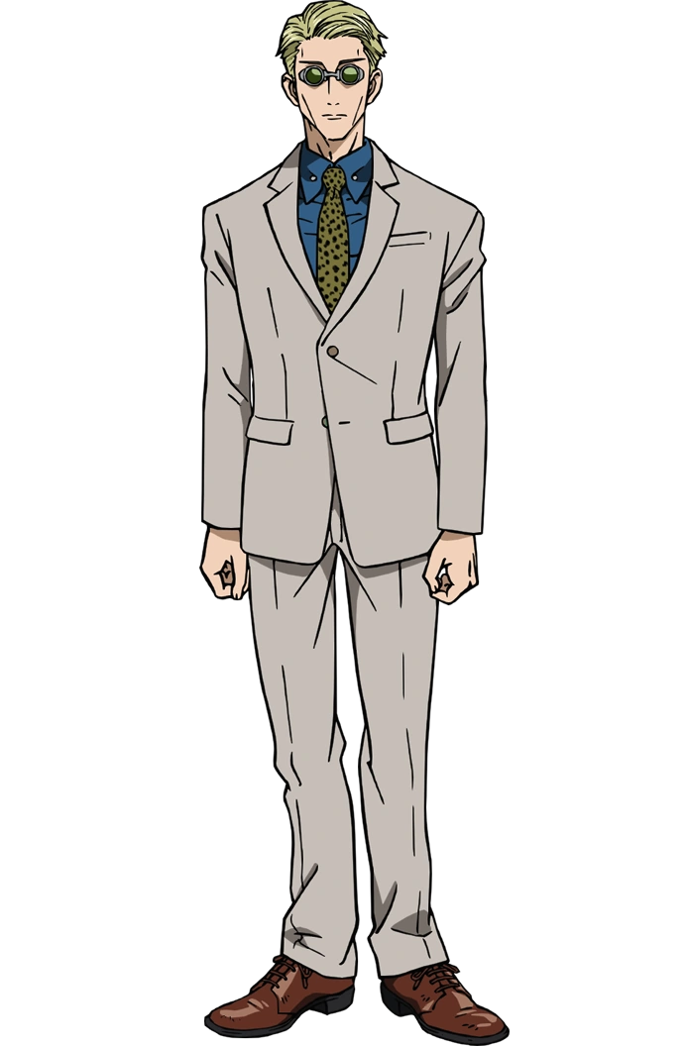
Conclusion
Streamline Gardening Experience
Market Opportunity
Provide differentiating features to stand out
User Centric Design
Avoid the pitfalls of our competitors
Notes:
Differentiating Features: After analyzing existing solutions from competitors, customers place a huge importance on sensor accuracy, affordability, and a device that is simple to use. To address the concerns and differentiate ourselves in the market, AquaGrowth Solutions will offer a unique set of features including a complete set of sensors, unlimited plant profiles, educational content, and reusability.
User Centric Approach:
To cater towards our users needs and make our product appealing in the market, moving forward, our focus will be on sensor accuracy and calibration to provide our users with reliable data. Additionally, we will provide our users with educational content and exploring the integration of machine learning algorithms to recommend plant care suggestions.
Streamlined Gardening Experience:
AquaGrowth Solutions intends to meet the needs of all gardeners by developing an easy to use solution. Whether our user is a veteran or just getting into gardening, our product will streamline the gardening experience.

Slide 13

Questions and Answers
Questions and Answers Session

